Slide 1

Machine learning: Ensemble methods
Boosting ; stumps
Notes:
In this study we have explored adaptive boosting - or AdaBoost - and compared its performance against the Random Forests algorithm, now used by a number of groups, including ourselves.

Slide 2
Learners: The weak versus the strong
One strong learner
Many weak learners
Difficult to build
Need lots of information
Specialised to problem
Can overfit
Easy to build
Each learner is barely better than guessing
Generality
Notes:
These methods use many weak learners, rather than a single strong learner.
Strong learners can be difficult to build and may require a lot of data. They are tuned to the problem at hand, but can overfit if tuned too closely.
Weak learners on the other hand are relatively easy to build. The term ‘weak learner’ comes from the idea that they are not really very good at learning! A single weak learner has a success rate of barely over 50%; only just better than guessing, or tossing a coin.
However, when brought together en masse, they gel to form good models. Better than the sum of their parts, you could say!

Slide 3
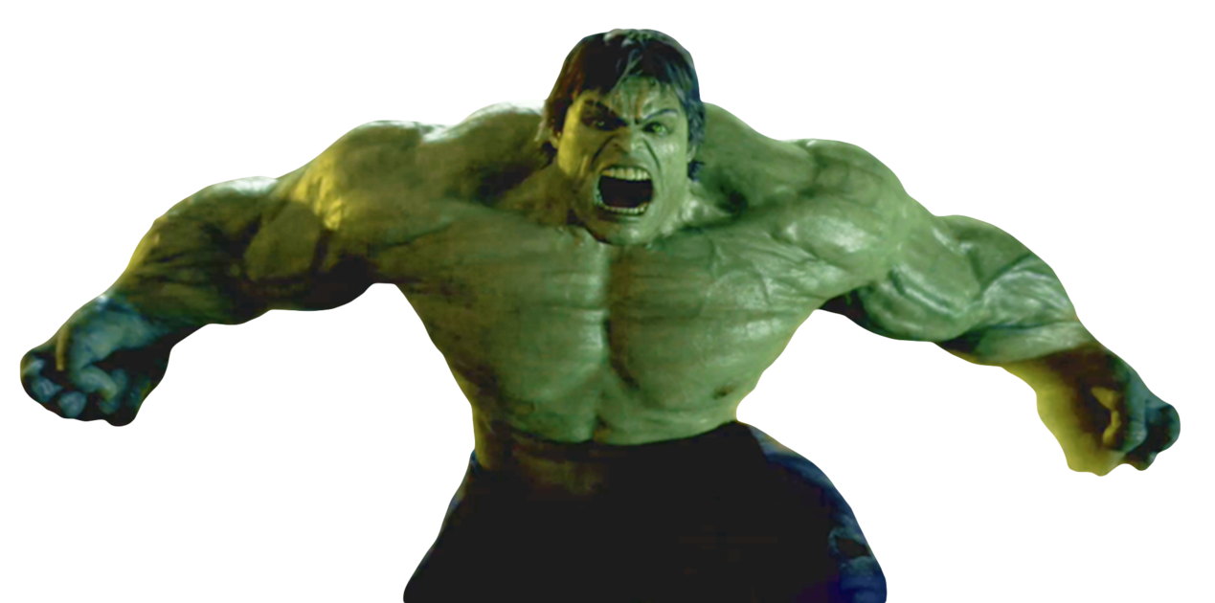
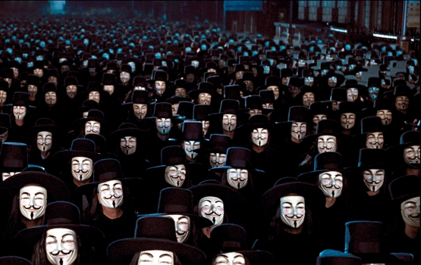
Learners: The weak versus the strong
One strong learner
Many weak learners
Difficult to build
Need lots of information
Specialised to problem
Can overfit
Easy to build
Each learner is barely better than guessing
Generality
The Incredible Hulk. Avengers: Endgame
V For Vendetta
Notes:
So, while a strong learner will be useful for specific challenges, weak learners benefit from: ‘the wisdom of the crowds’.

Slide 4
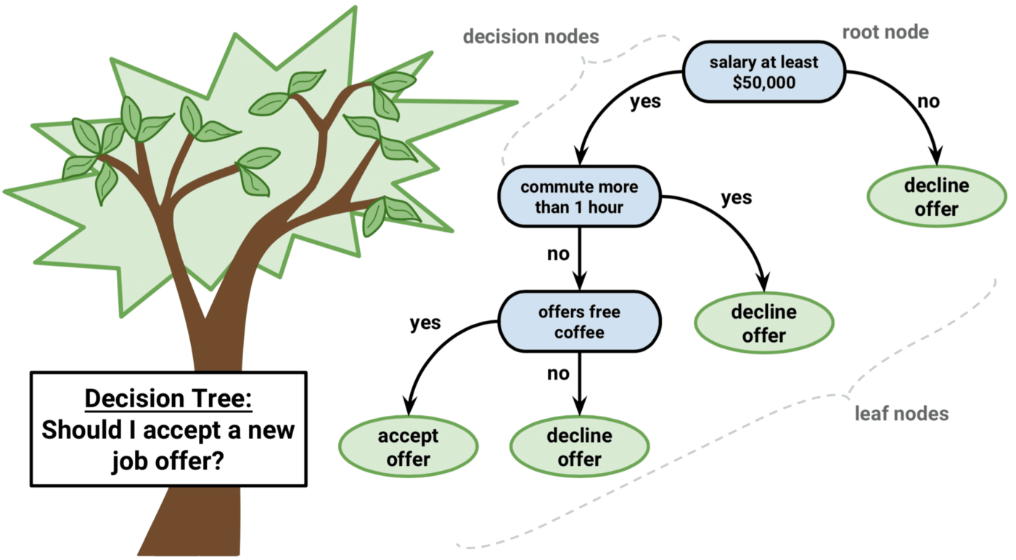
Decision tree
Most common weak learner
Each node defines a question
Variables can be Boolean, categories, or numeric ranges
Most critical question first, less important questions follow
https://medium.datadriveninvestor.com/decision-trees-lesson-101-f00dad6cba21
Notes:
The most common weak learner in ensemble learning is the decision tree, and these are used in both Random Forests and AdaBoost.
Here, the variable that best separates the training set data, becomes the ‘root node’. The data is then split into different branches. Each branch is considered separately, and the best variable for that branch becomes the decision point for the next split. The same variables can appear in different branches, in different orders, since the source data is changing after each split.
Eventually no further splits are required, and the outcome appears in leaf nodes.
Remember that these trees are not meant to be very good at making decisions! That’s the whole point!

Slide 5
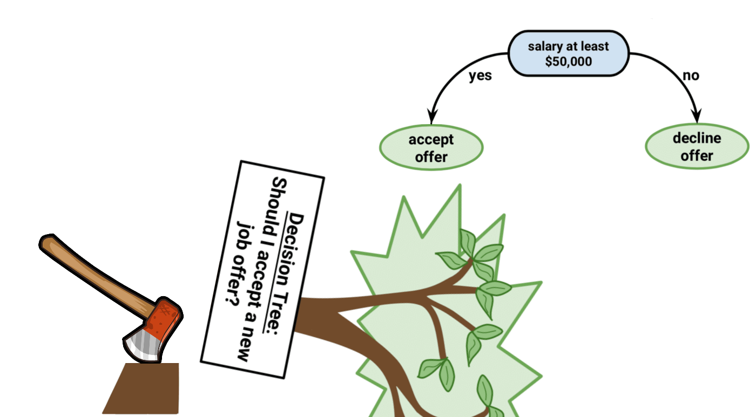
Decision stump
Very weak learner (~51%)
Only most critical question considered
https://medium.datadriveninvestor.com/decision-trees-lesson-101-f00dad6cba21
Notes:
For boosting approaches, AdaBoost being the first and most common, we make the decision trees even more ‘dumb’, by only allowing a single decision split. This produces, what’s called a ‘decision tree stump’. The root node is still defined around the variable that is most ‘important’ in separating the data in the training set, but other variables don’t get a look in. Because there is only one split, the tree can’t ‘refine’ its decision, so it just has to go, with what it’s got.

Slide 6
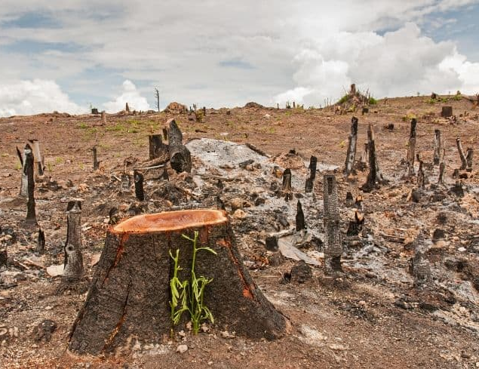
AdaBoost
Ensemble of decision tree stumps
Each tree gets different variables
One decision
Two leaves
Iterative
Example of ‘boosting’
Effectively a forest of stumps
https://www.conserve-energy-future.com/causes-effects-solutions-of-deforestation.php
Notes:
So, AdaBoost uses a collection of decision tree stumps, rather than full trees. Each tree gets different variables in the same way as Random Forests, but the trees only get to make a single choice.
The main difference between boosting techniques, such as AdaBoost, and a bagging approach like Random Forests, is that that boosting is ‘iterative’.
So AdaBoost is effectively a forest of stumps…

Slide 7
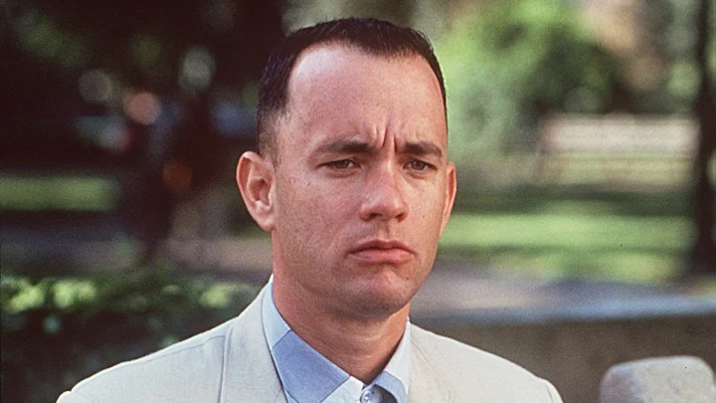



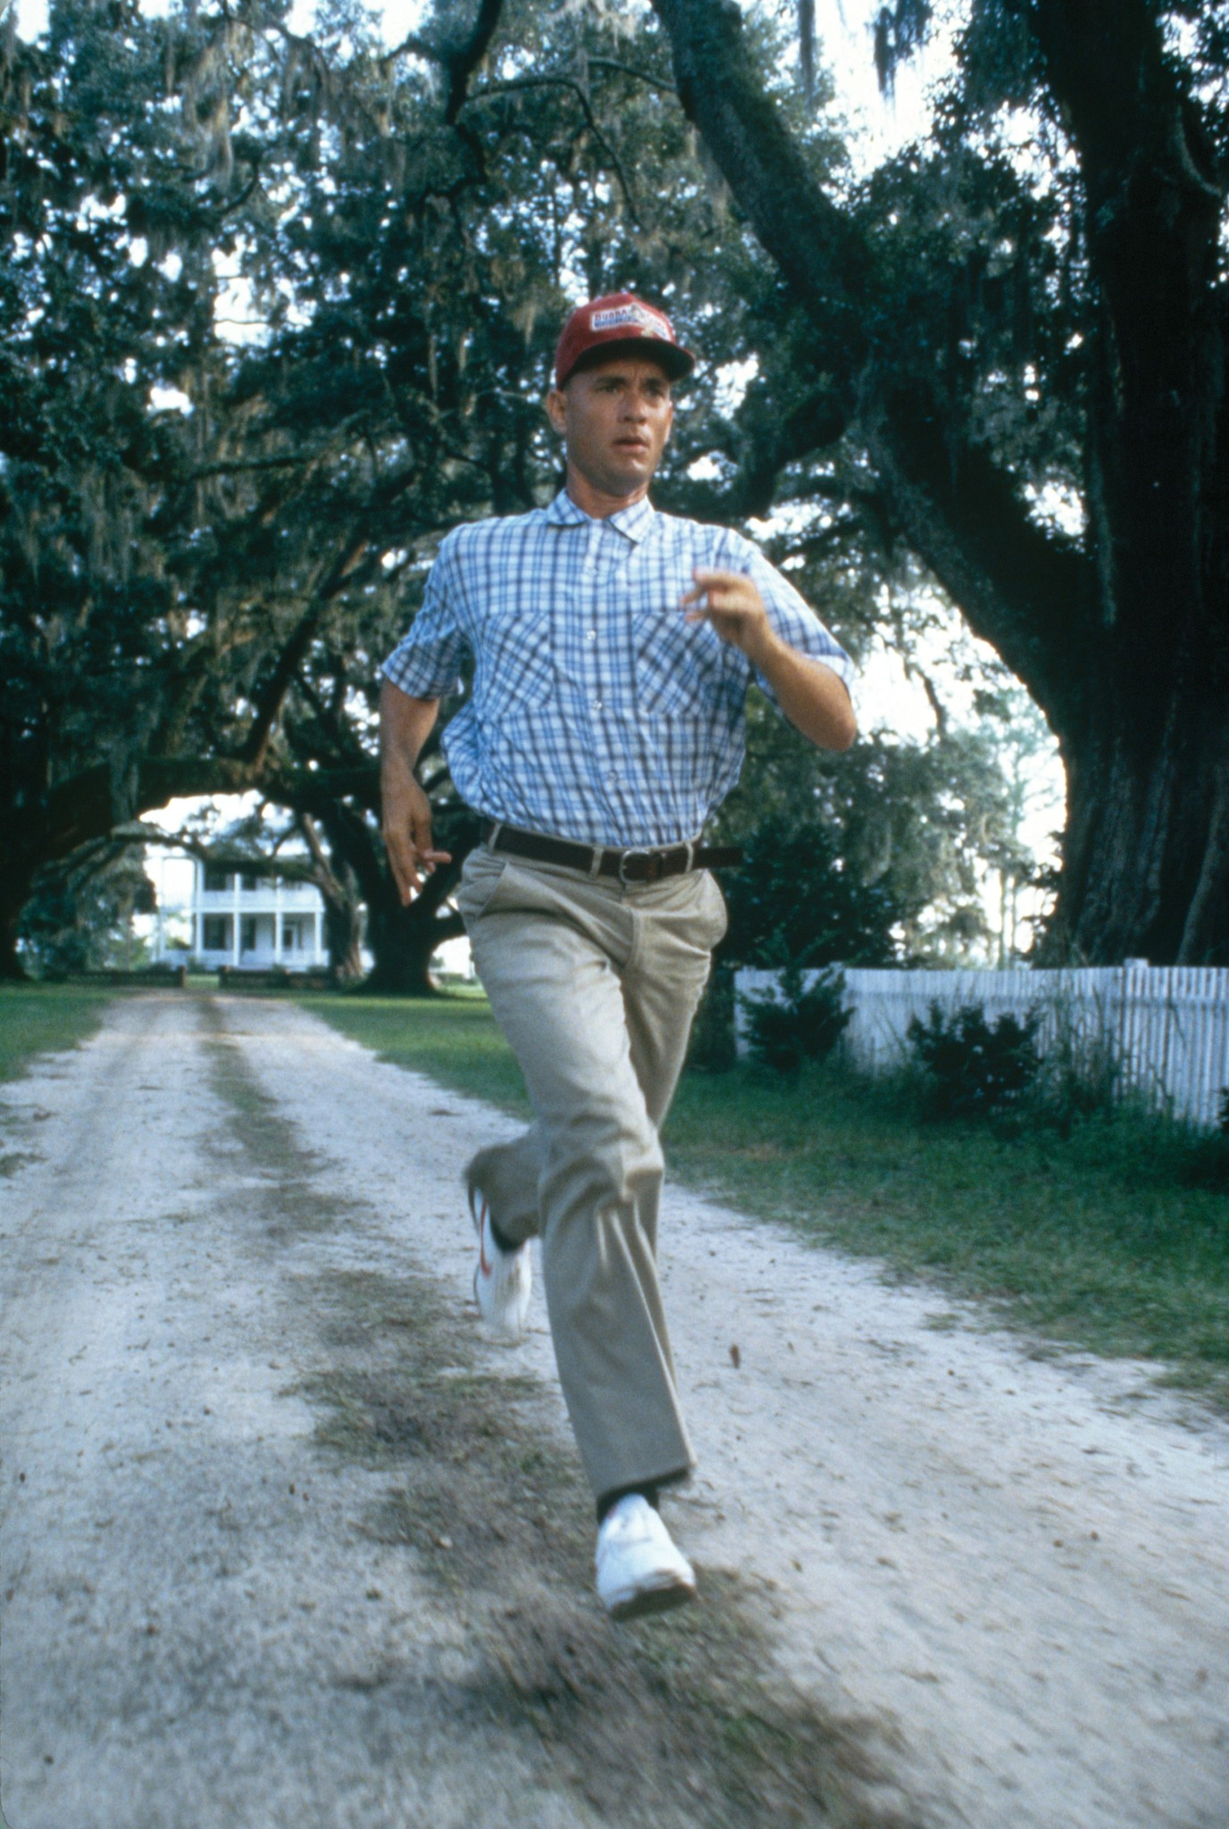
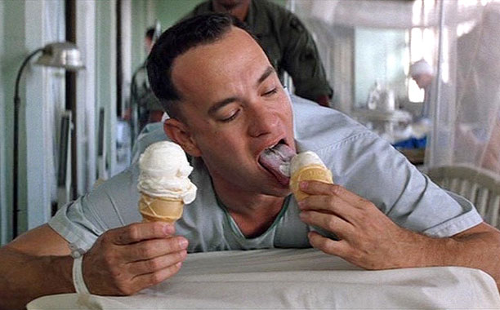
…a Forrest of Gumps!
Forrest Gump
Notes:
[CLICK] …not to be confused with…
…a Forrest of Gumps!
Sorry, couldn’t resist!

Slide 8
Adaptive Boosting: AdaBoost
Most common boosting approach
Notes:
The name AdaBoost is short for Adaptive Boosting. In this case the adaptive part is introduced by iteration and weighting.

Slide 9
AdaBoost USING STUMBS for binary classification
Importante Note : The order of stumps is very important
Notes:
[CLICK] To start with all samples are weighted equally. The decision tree (stump) then identifies a parameter that can split the data into class A or class B; in this case triangles and squares.
Any samples that were misclassified are then upweighted, with those correctly classified being downweighted. These modified data are then presented to a new decision tree. Since the weights on the previously misclassified samples are now higher, they are more likely to be correctly classified. Now, it is important to point out here that we’re not multiplying the spectral data points by this weighting; we’re changing their relative importance to the algorithm.
Next the misclassified samples from this second iteration are upweighted, with the correctly classified samples being downweighted, and we go for a third iteration.
After three iterations we stop, we combine the iterations and produce the ‘outcome’ of that tree ‘set’.
So, by iterating, and biasing each iteration in favour of samples there were wrongly classified in previous steps, we produce a stronger classifier. This might not be a VERY strong classifier, but it will be used in combination with others in the overall algorithm.
As with the Random Forests approach, when we introduce test data, each tree (or tree set) gets a vote for whichever class it thinks that test sample should fall into. There are various metrics that can be used here, but the majority vote is the easiest to think about and easiest to apply.

Slide 10
AdaBoost iterations
Iteration 3
Combine iterations, with weightings
Iteration 1
Model
weak classifier
Iteration 2
weak classifier
stronger classifier
Misclassified samples upweighted
Correctly classified, downweighted
Misclassified samples upweighted
Correctly classified, downweighted
weak classifier
Notes:
[CLICK] To start with all samples are weighted equally. The decision tree (stump) then identifies a parameter that can split the data into class A or class B; in this case triangles and squares.
Any samples that were misclassified are then upweighted, with those correctly classified being downweighted. These modified data are then presented to a new decision tree. Since the weights on the previously misclassified samples are now higher, they are more likely to be correctly classified. Now, it is important to point out here that we’re not multiplying the spectral data points by this weighting; we’re changing their relative importance to the algorithm.
Next the misclassified samples from this second iteration are upweighted, with the correctly classified samples being downweighted, and we go for a third iteration.
After three iterations we stop, we combine the iterations and produce the ‘outcome’ of that tree ‘set’.
So, by iterating, and biasing each iteration in favour of samples there were wrongly classified in previous steps, we produce a stronger classifier. This might not be a VERY strong classifier, but it will be used in combination with others in the overall algorithm.
As with the Random Forests approach, when we introduce test data, each tree (or tree set) gets a vote for whichever class it thinks that test sample should fall into. There are various metrics that can be used here, but the majority vote is the easiest to think about and easiest to apply.

Slide 11
AdaBoost Animated
Notes:
[CLICK] To start with all samples are weighted equally. The decision tree (stump) then identifies a parameter that can split the data into class A or class B; in this case triangles and squares.
Any samples that were misclassified are then upweighted, with those correctly classified being downweighted. These modified data are then presented to a new decision tree. Since the weights on the previously misclassified samples are now higher, they are more likely to be correctly classified. Now, it is important to point out here that we’re not multiplying the spectral data points by this weighting; we’re changing their relative importance to the algorithm.
Next the misclassified samples from this second iteration are upweighted, with the correctly classified samples being downweighted, and we go for a third iteration.
After three iterations we stop, we combine the iterations and produce the ‘outcome’ of that tree ‘set’.
So, by iterating, and biasing each iteration in favour of samples there were wrongly classified in previous steps, we produce a stronger classifier. This might not be a VERY strong classifier, but it will be used in combination with others in the overall algorithm.
As with the Random Forests approach, when we introduce test data, each tree (or tree set) gets a vote for whichever class it thinks that test sample should fall into. There are various metrics that can be used here, but the majority vote is the easiest to think about and easiest to apply.

Slide 12
AdaBoost PROS AND CONS
PROS | CONS
effectively combine multiple weak classifier to create a strong classifier with high accuracy. | Sensitive to outliers and noisy data
It can handle complex datasets and capture intricate patterns | Computationaly intensive
Mitigates the risk of overfitting the training data | Appropriate selection of weak classifier and number of iterations is crucial for adaboost performance
Adaboost allows flexibilty in modeling | Struggle with imbalance data
Notes:
[CLICK] To start with all samples are weighted equally. The decision tree (stump) then identifies a parameter that can split the data into class A or class B; in this case triangles and squares.
Any samples that were misclassified are then upweighted, with those correctly classified being downweighted. These modified data are then presented to a new decision tree. Since the weights on the previously misclassified samples are now higher, they are more likely to be correctly classified. Now, it is important to point out here that we’re not multiplying the spectral data points by this weighting; we’re changing their relative importance to the algorithm.
Next the misclassified samples from this second iteration are upweighted, with the correctly classified samples being downweighted, and we go for a third iteration.
After three iterations we stop, we combine the iterations and produce the ‘outcome’ of that tree ‘set’.
So, by iterating, and biasing each iteration in favour of samples there were wrongly classified in previous steps, we produce a stronger classifier. This might not be a VERY strong classifier, but it will be used in combination with others in the overall algorithm.
As with the Random Forests approach, when we introduce test data, each tree (or tree set) gets a vote for whichever class it thinks that test sample should fall into. There are various metrics that can be used here, but the majority vote is the easiest to think about and easiest to apply.

Slide 13
Conclusion
AdaBoost combines a lot of “weak learners” to make classification. The weak learner are almost always stumps.
Some stumps get more say in the classification than others.
Each stump is made by taking the previous stump’s mistakes into account.
Notes:
[CLICK] To start with all samples are weighted equally. The decision tree (stump) then identifies a parameter that can split the data into class A or class B; in this case triangles and squares.
Any samples that were misclassified are then upweighted, with those correctly classified being downweighted. These modified data are then presented to a new decision tree. Since the weights on the previously misclassified samples are now higher, they are more likely to be correctly classified. Now, it is important to point out here that we’re not multiplying the spectral data points by this weighting; we’re changing their relative importance to the algorithm.
Next the misclassified samples from this second iteration are upweighted, with the correctly classified samples being downweighted, and we go for a third iteration.
After three iterations we stop, we combine the iterations and produce the ‘outcome’ of that tree ‘set’.
So, by iterating, and biasing each iteration in favour of samples there were wrongly classified in previous steps, we produce a stronger classifier. This might not be a VERY strong classifier, but it will be used in combination with others in the overall algorithm.
As with the Random Forests approach, when we introduce test data, each tree (or tree set) gets a vote for whichever class it thinks that test sample should fall into. There are various metrics that can be used here, but the majority vote is the easiest to think about and easiest to apply.

Slide 14
Resources
AdaBoost, Clearly Explained - YouTube (Notebook)
What is AdaBoost (BOOSTING TECHNIQUES) - YouTube
AdaBoost Algorithm in Machine Learning - Almabetter
Understanding the AdaBoost Algorithm - Medium
an interactive dashboard to adaptive boosting algorithmGitHub

